Slide 1

AI-Powered Natural Language to SQL for Enterprise Data
Transforming how business teams access data by enabling natural language queries without SQL knowledge.

Slide 2




The Current Data Access Challenge
Business Request
Developer Time
Teams need data insights but lack SQL expertise
Technical resources must write custom SQL queries
SQL Query
Report Delivery
Code must be written, tested and optimized
Results delivered with significant time delays
Our Goal: Build a real-time natural language to SQL pipeline that eliminates these bottlenecks.

Slide 3

Proof of Concept Overview
Natural Language Input
Users ask questions in plain English
AI-Generated SQL
System converts question to optimized SQL
Database Execution
Queries run against Postgres/Oracle DB
Real-Time Results
Data displayed instantly via UI

Slide 4
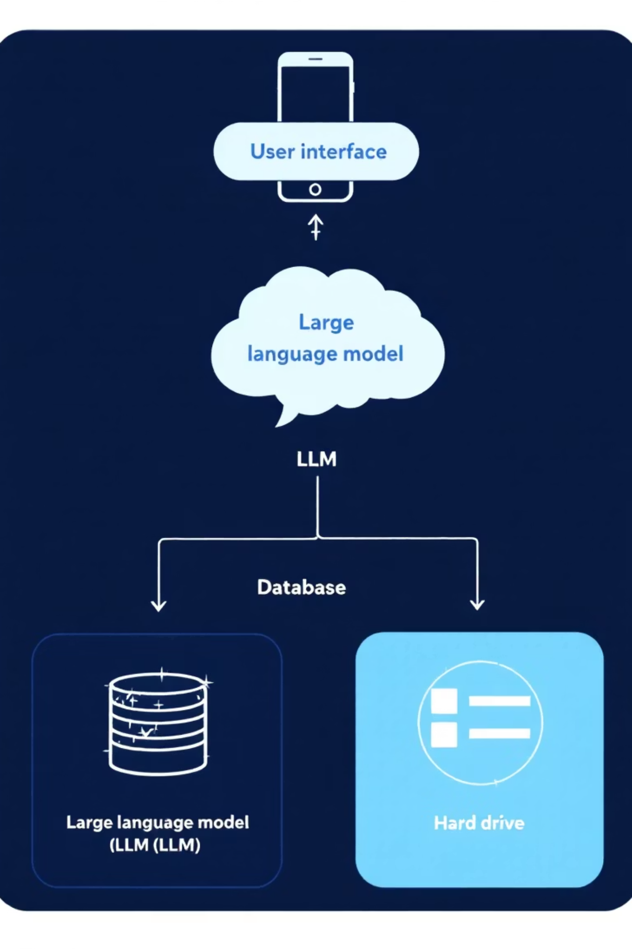
Technical Architecture
User Interface
1
Gradio-powered front-end with query input field and results display
LLM Integration
2
OpenAI models process natural language via LangChain framework
Database Layer
3
Connection pooling for performance with Postgres/Oracle backends
Optional: Pinecone vector database for semantic retrieval of relevant schemas

Slide 5
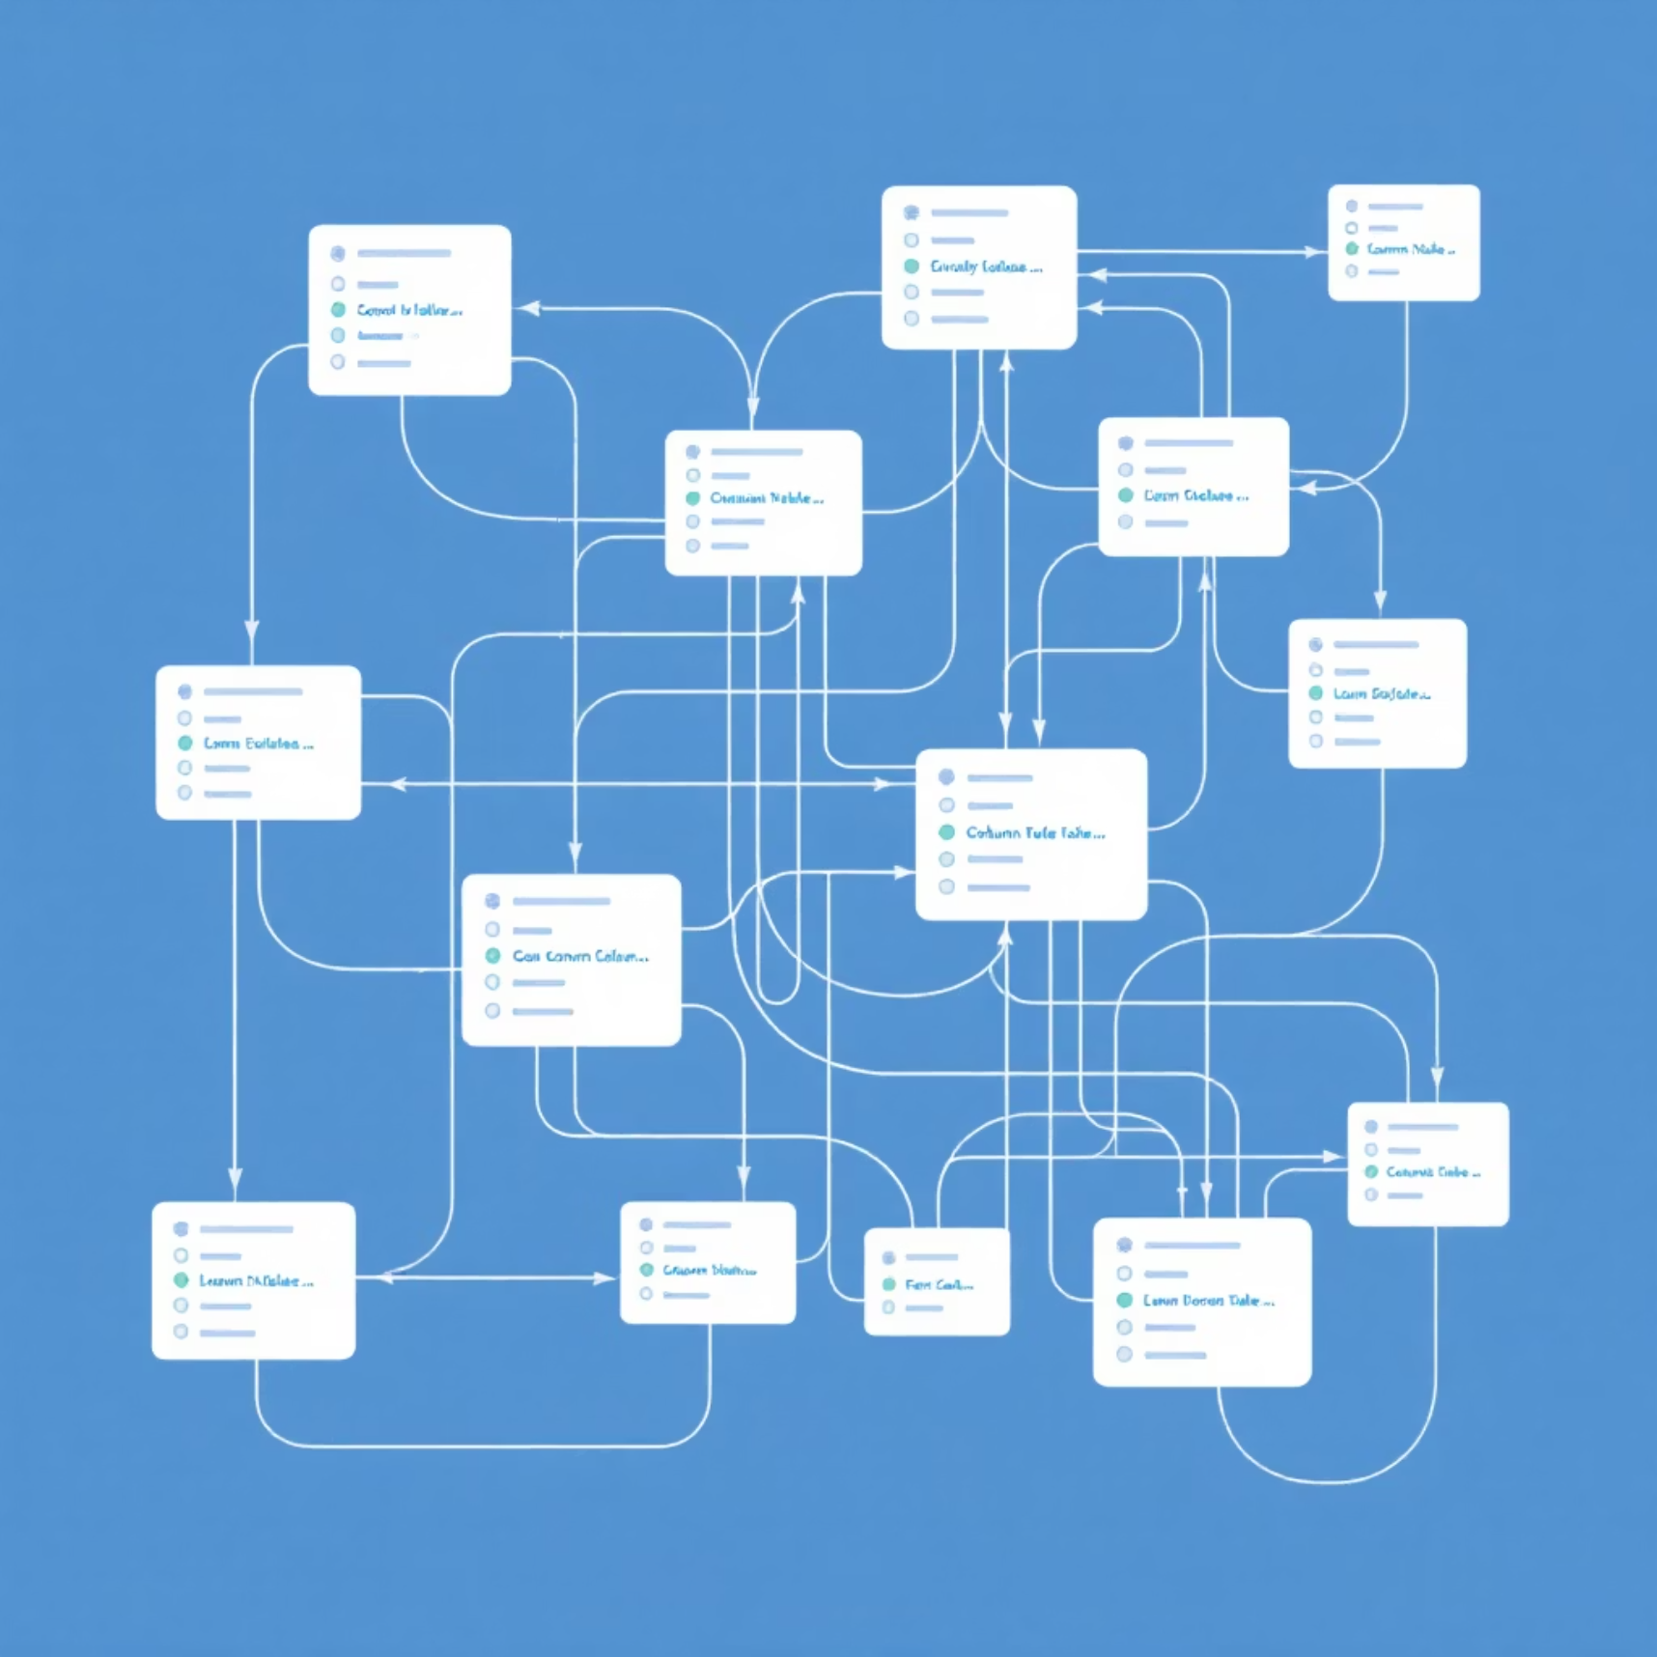
The Multi-Table Challenge
Naming Collisions
Common columns (id, name, created_at) exist across tables
Schema Confusion
Naive vector search returns mixed schema information
Join Complexity
LLM might create incorrect table joins or select wrong fields
Managing 50+ tables requires sophisticated context management to prevent errors

Slide 6
Our Technical Solution
1
2
Per-Table Embeddings
Domain Namespaces
Each table schema embedded separately with rich metadata
HR tables vs Finance tables kept in separate contexts
Preserves table context
Filters limit scope to relevant domains
Prevents cross-contamination
Reduces ambiguity in retrieval
3
4
Multi-Step Retrieval
Business Descriptions
Progressive refinement of context
Semantic table definitions guide the LLM
Detect relevant tables
Example: "Employees table: staff salary info"
Fetch schema & sample rows
Improves accuracy of table selection
Generate optimized SQL

Slide 7





Business Benefits
Real-Time Access
Instant data retrieval without waiting for reports
No SQL Required
Business users ask questions in natural language
Enterprise Scale
Works across 50+ tables and multiple domains
Time Savings
Eliminates developer bottlenecks and reporting delays

Slide 8
Implementation Roadmap
Phase 1: Expand POC
1
Integrate all 50 tables
Complete schema embeddings
Implement domain filters
2
Phase 2: Security Layer
Add authentication framework
Implement role-based access controls
Phase 3: Performance
3
Establish query audit logging
Optimize query execution
Implement result caching
4
Phase 4: Deployment
Scale connection pooling
Internal server setup
Monitoring and alerting
User training and documentation

Slide 9

Live Demo
Sample Query
Generated SQL
Results
"Show employees in Bangalore earning more than 5000"
Table with matching employee data displayed instantly
SELECT name, department, salary FROM employees WHERE location = 'Bangalore' AND salary > 5000 ORDER BY salary DESC;

Slide 10




Deliverables
PowerPoint Presentation
Complete .pptx with architecture diagrams
PDF Documentation
Shareable document for management review
Code Repository
POC implementation with documentation
All deliverables will include comprehensive documentation, screenshots of the working UI, and key code snippets for technical review.

